Slide 1
Banking Application Capstone Presentation
Maxim Shlyaptsev

Slide 2
Part 1: Front-End Architecture, Authentication, And App Diagram

Slide 3


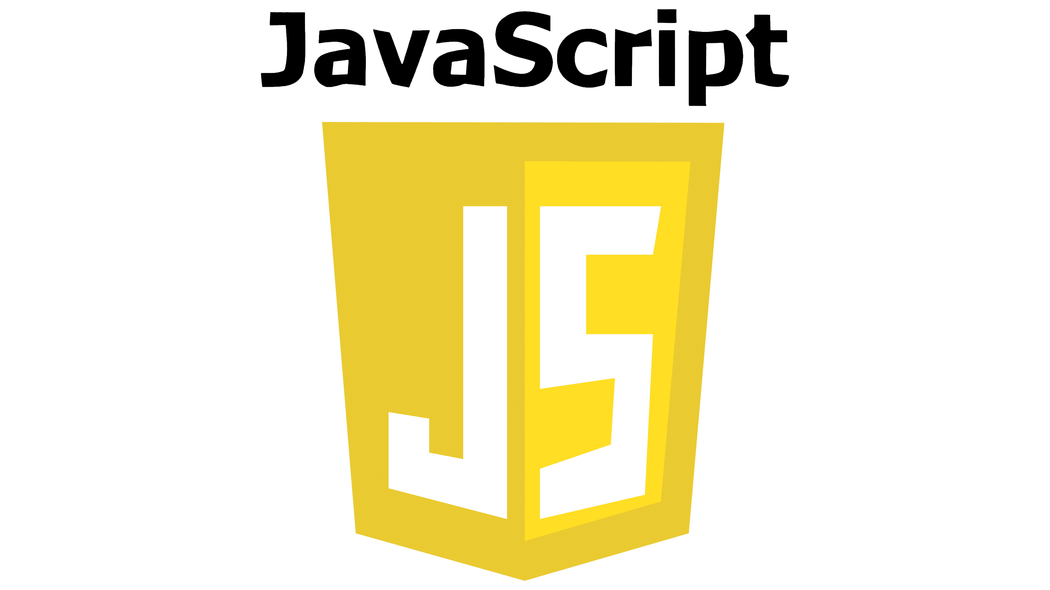




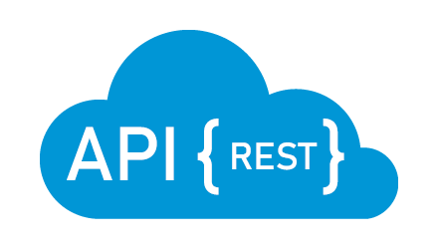






Application Overview Diagram
Frontend
Backend
Database

Slide 4
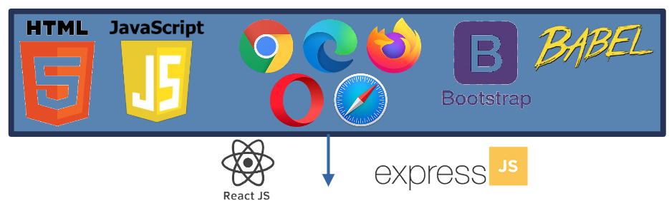

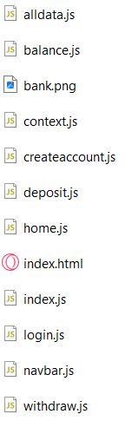
Front-End Architecture

Slide 5
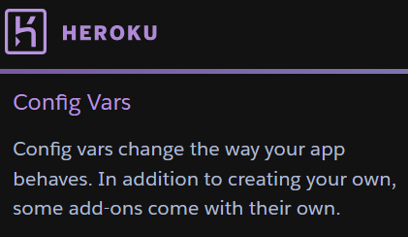

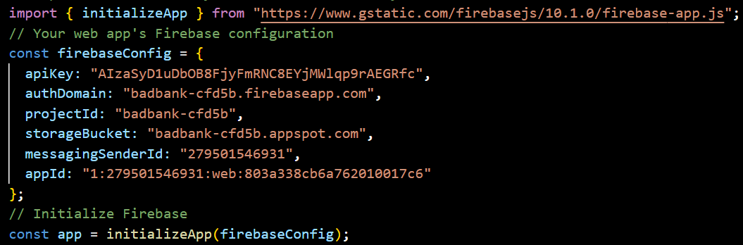
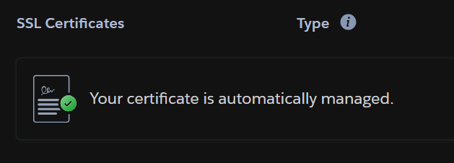
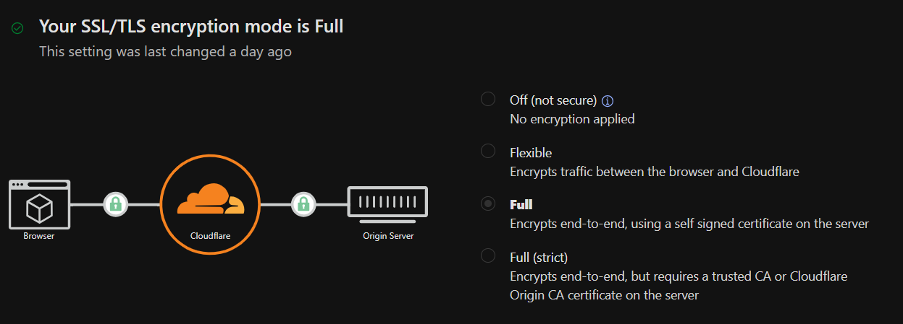


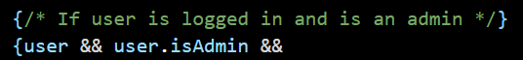
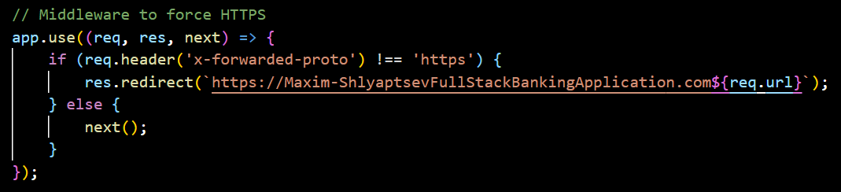
Authentication
index.html
Proprietary code
index.html

Slide 6
Part 2: Database And API

Slide 7

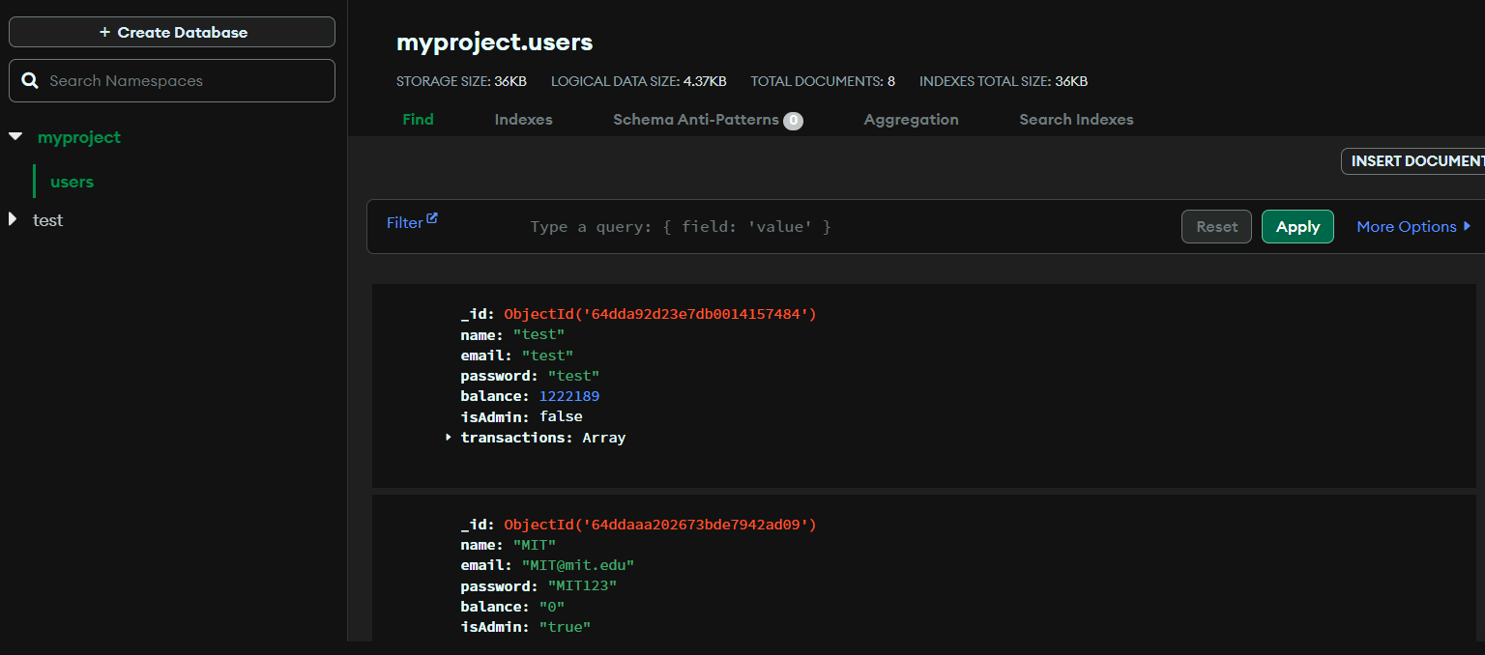
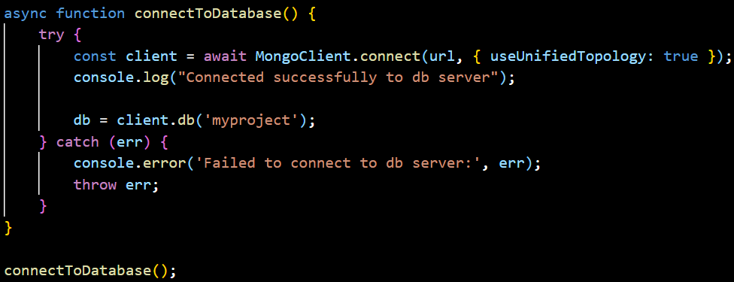
Database

Slide 8
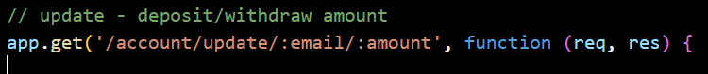
API
(backend) index.js
(frontend) deposit.js

Slide 9
Part 3: Deployment, Additional Features, App Demonstration, Reflection

Slide 10
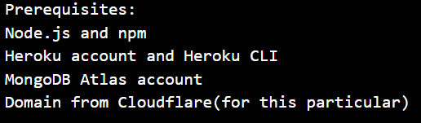
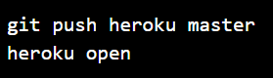
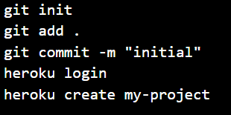
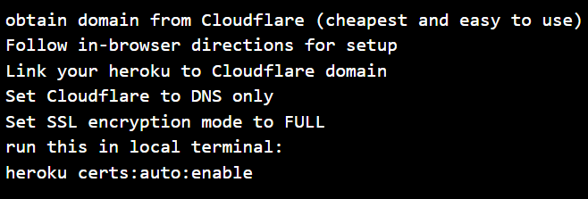
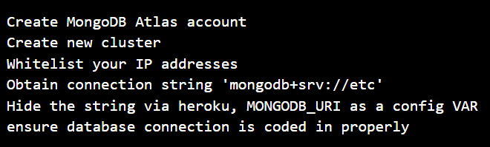
Deployment
HIGHLY recommend getting app working ‘barebones’ and Deploy ASAP so you can recognize dependencies/issues and dissect them first. Once your website is functional – then the refactoring part is easy and you can always see what your website looks like as you build it, which gives a nice dopaminergic boost every time you succeed.

Slide 11
Additional Features
Web tab title change + logo icon added navbar.js completely redone- added logout functionality, visible logo branding that is clickable to go home, user detection and admin detection and navbar display changes according to the user and user type with UI changes across the board. alldata.js – created filtered data to display transaction history under specific user, encapsulated it in a protected route so that only an admin can access the page
balance.js – accesses userContext to check for and display transaction history if available with associated UI changes context.js – added much more to userContext (user/setuser/updateUserBalance/updateUserTransactions) created window.userContext object to link throughout the frontend in old-school JS.
createaccount.js – added input validation, added bootstrap style for textbox highlighting for seamless UI, added requirement for FULL name and proper email address as well as minimum 3 character password.
deposit.js – added input validation (no 0 or negatives), added transaction history logging and verification, added new balance screen as well as balance confirmation screen to show updated balance after deposit.
Index.js (frontend) – added protected routes and admin verification, added userBalance and userTransaction update functions that can be linked anywhere else as needed, updated userContext.Provider
Login.js – added userContext update to verify that user is logged in so that the navbar can verify and display new options. Changed login success screen to show something completely different :) withdraw.js – added input verification and update functions same as deposit.js

Slide 12
Additional Features
dal.js – added proper asynchronous database connection function, refactored update function to include transaction history
index.js (backend) – added middleware for HTTPS routing, refactored update routing to include transaction history and associated methods, added proper .env.PORT routing
*many more refactors I surely have forgotten along the way*

Slide 13
Application Demonstration – Create Account, Log In, Deposit, Withdraw
Maxim-ShlyaptsevFullStackBankingApplication.com

Slide 14
Reflection
Before you even start refactoring, take notes on every single detail you want to change first. Then you will
realize all the modules you will need and the priority of their installation, otherwise you will find yourself
refactoring your own code to get things working.
Difficult working with starter files, I should’ve started from scratch. A lot of coding malpractices that I think
were planted for us to ‘learn’
In a professional team environment, documentation of ‘patch notes’ is imperative, during my solo work I did
not document anything and just ‘went with the flow’ since I was solely responsible, which was easy, but
when I had to make this powerpoint I wasted tons of time reflecting on what I changed.
Deployment is priority #1 in my opinion, then modifications are easy. If you start by refactoring everything and
then finding out you have an issue with dependencies or x y and z when deploying through a specific
system it becomes a nightmare.
Before you even start refactoring, take notes on every single detail you want to change first. Then you will
realize all the modules you will need and the priority of their installation, otherwise you will find yourself
refactoring your own code to get things working.

